Slide 1
Vital Signs
Practical guide
Dr Thierno A DIALLO, cardiologist
The UTG, BANJUL 18th October 2015

Slide 2
The measurement
Vital signs include the measurement of:
temperature,
respiratory rate,
pulse,
blood pressure
And, when appropriate:
blood oxygen saturation.
These numbers provide critical information (hence the name "vital") about a patient's state of health

Slide 3
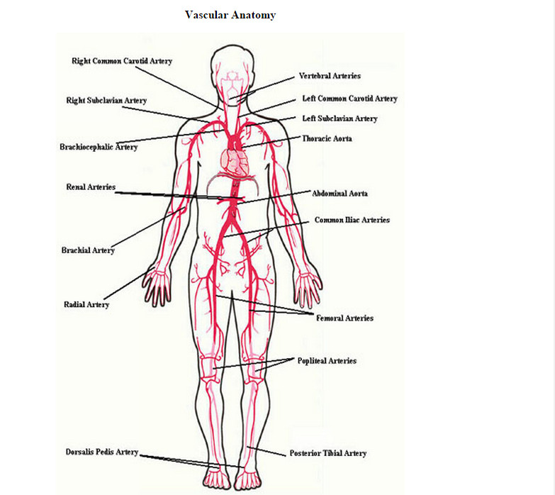
Vascular Anatomy

Slide 4
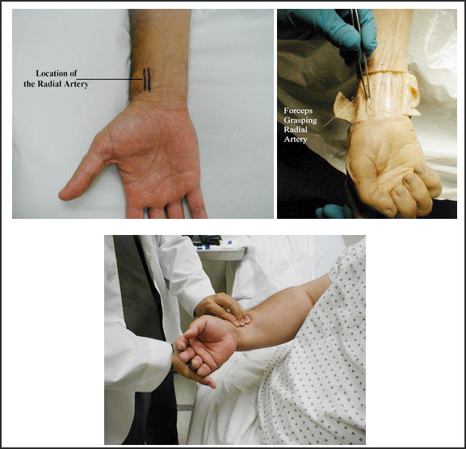
Radial Pulse

Slide 5
Taking The Pulse
Push lightly at first, adding pressure if there is a lot of subcutaneous fat or you are unable to detect a pulse. If you push too hard, you might occlude the vessel and mistake your own pulse for that of the patient. During palpation, note the following:
Quantity: Measure the rate of the pulse (recorded in beats per minute). Count for 30 seconds and multiply by 2 (or 15 seconds x 4). If the rate is particularly slow or fast, it is probably best to measure for a full 60 seconds in order to minimize the impact of any error in recording over shorter periods of time. Normal is between 60 and 100.

Slide 6
The Pulse- continued
Regularity: Is the time between beats constant? In the normal setting, the heart rate should appear metronomic. Irregular rhythms, however, are quite common. If the pattern is entirely chaotic with no discernable pattern, it is referred to as irregularly irregular and likely represents atrial fibrillation. Extra beats can also be added into the normal pattern, in which case the rhythm is described as regularly irregular.
Volume: Does the pulse volume (i.e. the subjective sense of fullness) feel normal? This reflects changes in stroke volume. In the setting of hypovolemia, for example, the pulse volume is relatively low (aka weak or thready). There may even be beat to beat variation in the volume, occurring occasionally with systolic heart failure.

Slide 7
Blood Pressure
Blood pressure (BP) is measured using mercury based manometers, with readings reported in millimeters of mercury (mm Hg). The size of the BP cuff will affect the accuracy of these readings.
The inflatable bladder, which can be felt through the vinyl covering of the cuff, should reach roughly 80% around the circumference of the arm while its width should cover roughly 40%. If it is too small, the readings will be artificially elevated. The opposite occurs if the cuff is too large.
Clinics should have at least 3 cuff sizes available, children, normal and large.
In order to measure the BP, proceed as follows: Wrap the cuff around the patient's upper arm so that the line marked "artery" is roughly over the brachial artery, located towards the medial aspect of the antecubital fossa (i.e. the crook on the inside of their elbow). The placement does not have to be exact nor do you actually need to identify this artery by palpation.

Slide 8
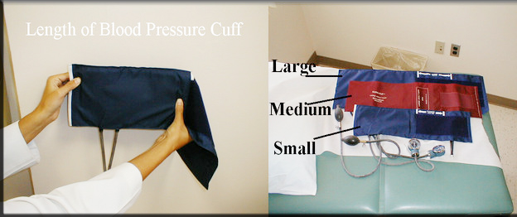
Technique
Wrap the cuff around the patient's upper arm so that the line marked "artery" is roughly over the brachial artery

Slide 9
A few clinically relevant thoughts about high blood pressure (Ohio S U):
Hypertension is very common disease (> 25% in US affected). In South Africa, for example, up to 50% of the people between the ages of 40 and 60 suffered from high blood pressure.
In addition, there were also stark difference in different settings in the same countries. And in some areas despite treatment being high, people’s blood pressure was not under control, raising questions about the effectiveness of their treatment and how well they stuck to drug regimens. HBP & defined on basis of severity:
Pre-hypertension : Systolic BP 120-140 or diastolic BP 80-90.
Stage I hypertension: Systolic BP > 140-160 or diastolic BP >90-100.
Stage II: Systolic BP > 160 or diastolic BP > 100.
Ideally, several measures on different occasions should verify the finding. One time measures > 160/100 also confirms the diagnosis. It's worth mentioning that normal is 110s/70s, and cardiovascular risk rises w/any values above these points.

Slide 10
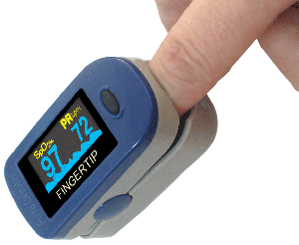
Oxygen Saturation
The red blood cell oxygen carrying capacity has become available in all hospitals and many clinics. While imperfect, it can provide important information about cardio-pulmonary dysfunction and is considered by many to be a fifth vital sign. In particular, for those suffering from either acute or chronic cardio-pulmonary disorders, it can help quantify the degree of impairment

Slide 11
Body temperature 1
The normal body temperature of a person varies depending on gender, recent activity, food and fluid consumption, time of day, and, in women, the stage of the menstrual cycle. Normal body temperature can range from 36.5 degrees C, or Celsius to 37.2 degrees C for a healthy adult. A person's body temperature can be taken in any of the following ways:
Orally. Temperature can be taken by mouth using either the classic glass thermometer, or the more modern digital thermometers that use an electronic probe to measure body temperature.
Rectally. Temperatures taken rectally (using a glass or digital thermometer) tend to be 0.5 to 0.7 degrees higher than when taken by mouth.
Axillary. Temperatures can be taken under the arm using a glass or digital thermometer. Temperatures taken by this route tend to be 0.3 to 0.4 degrees lower than those temperatures taken by mouth.

Slide 12
Body Temperature 2
By ear. A special thermometer can quickly measure the temperature of the ear drum, which reflects the body's core temperature (the temperature of the internal organs).
By skin. A special thermometer can quickly measure the temperature of the skin on the forehead.
Body temperature may be abnormal due to fever (high temperature) or hypothermia (low temperature). A fever is indicated when body temperature rises about one degree or more over the normal temperature of 37,6 degrees (American Academy of Family Physicians)

Slide 13
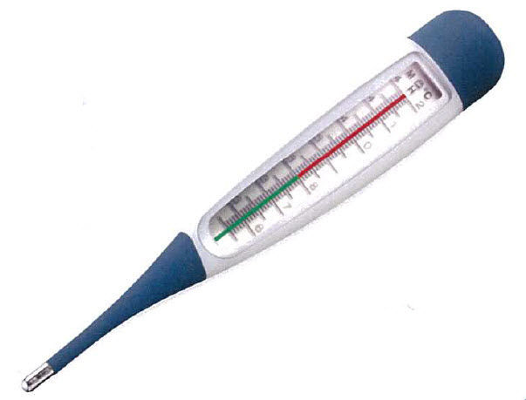
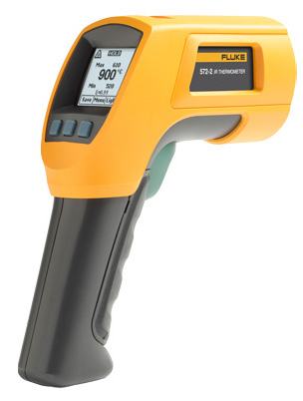
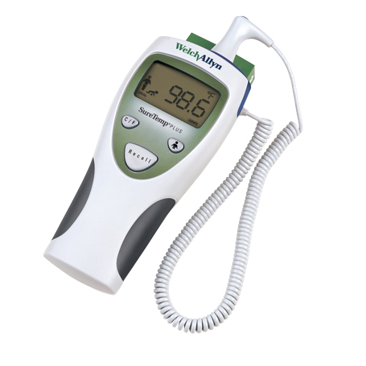
Differents Types of Thermometers

Slide 14
Height, Weight, Body Mass Index
Often forgotten, are also “vital signs”
Body mass index (BMI) is a measure of how healthy your weight is. Your BMI is calculated using your height and your weight:
BMI = weight (kg) divided by height squared (m2)
For example: the BMI of someone who is 175 cm tall (i.e. 1.75 m) who weighs 100 kg is worked out as follows:
BMI = 100 [weight in kg]/1.75 x 1.75 [height in m2] = 100/3.06
BMI = 32.6

Slide 15
BMI Categories
BMI categories for people :
Underweight: lower than 18.5
Healthy: 18.5–24.9
Overweight: 25–29.9
Obese: 30 -39
Morbid obese 40 or higher

Slide 16
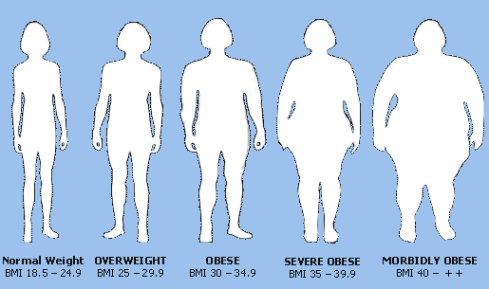
Frequents Risks Factors linked with Obesity (Mayo Clionic)
Heart disease
Diabetes
Abnormal cholesterol — a high triglyceride level but a low level of high-density lipoprotein (HDL, or "good") cholesterol
High blood pressure
Metabolic syndrome

Slide 17
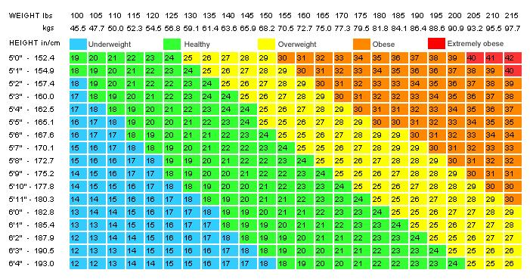
Weight Chart

Slide 18
Last Word
Thank You for your attention
Merci pour votre attention

